Slide 1

Metabolomics & Transcriptomics
Data Analysis for Daphnia magna

Slide 2
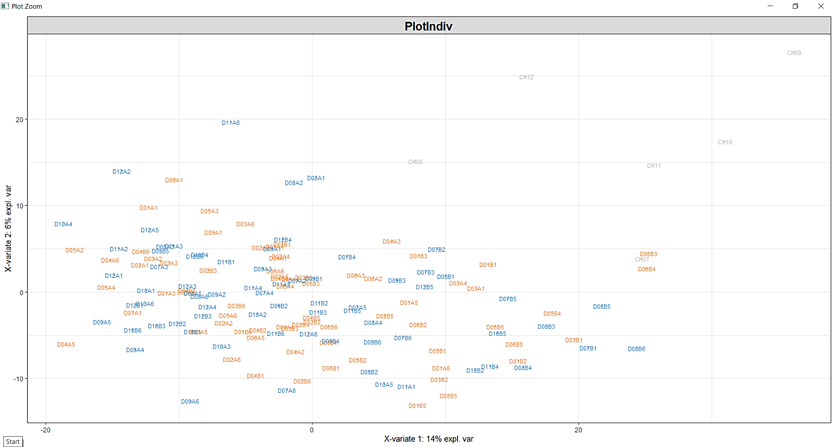
Positive Metabolome Clustering – PLS DA

Slide 3
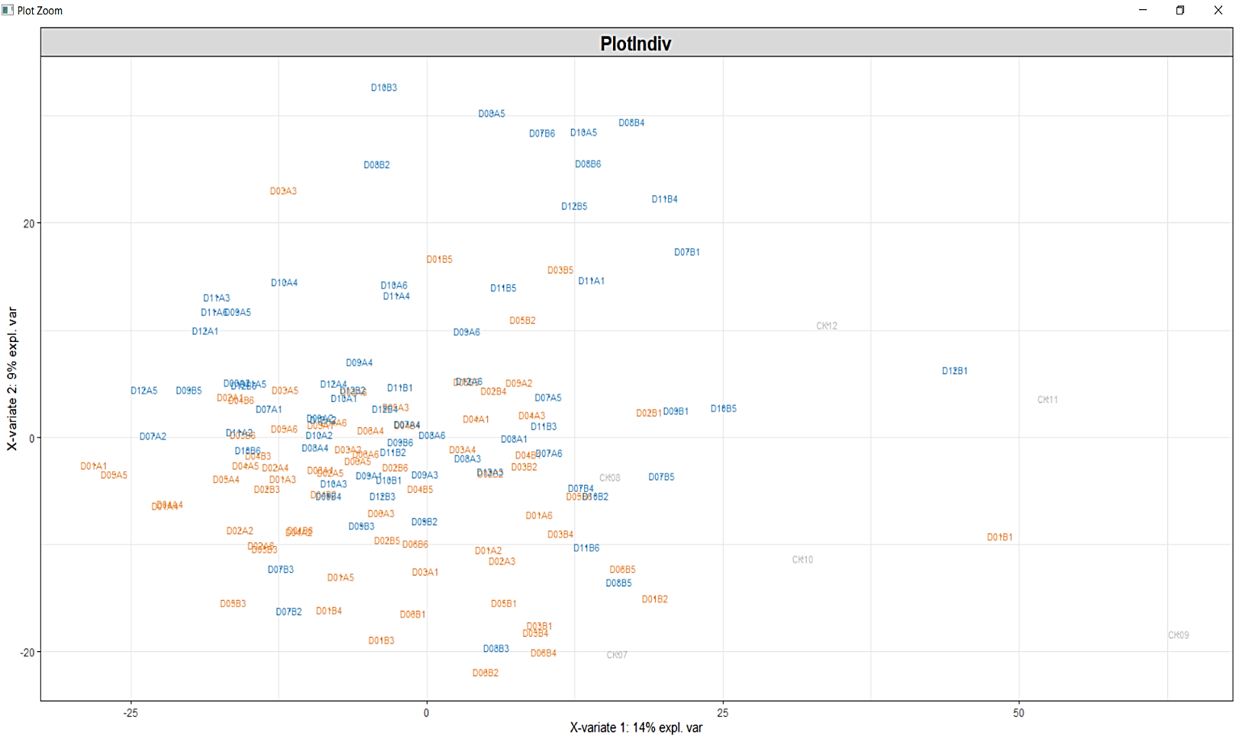
Negative Metabolome Clustering – PLS DA

Slide 4
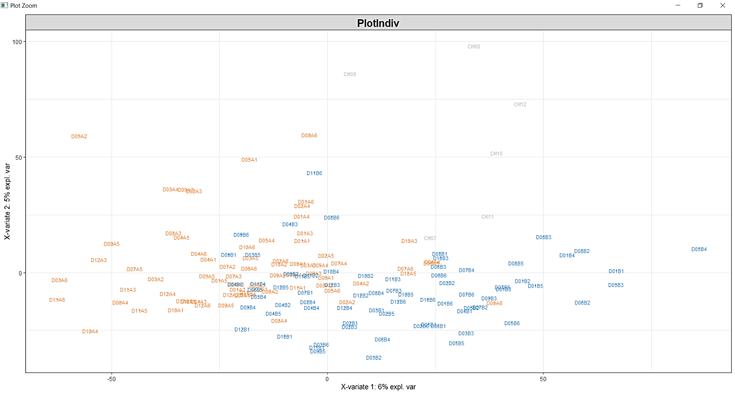
RNA sequence count data

Slide 5
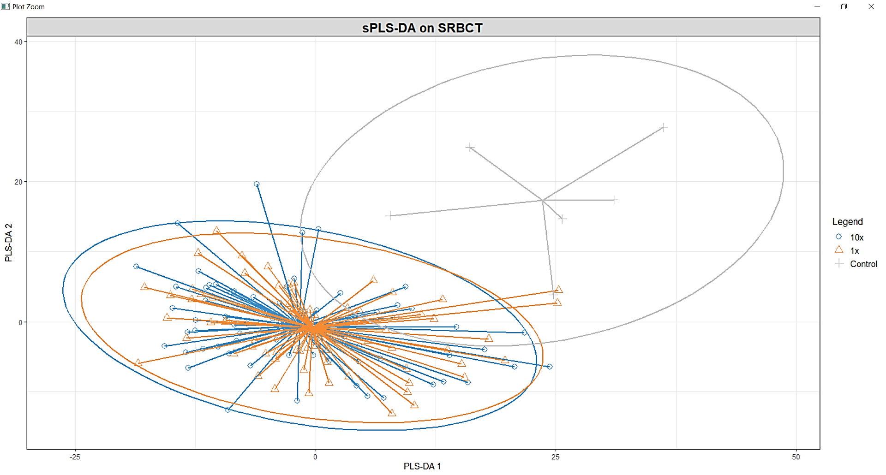
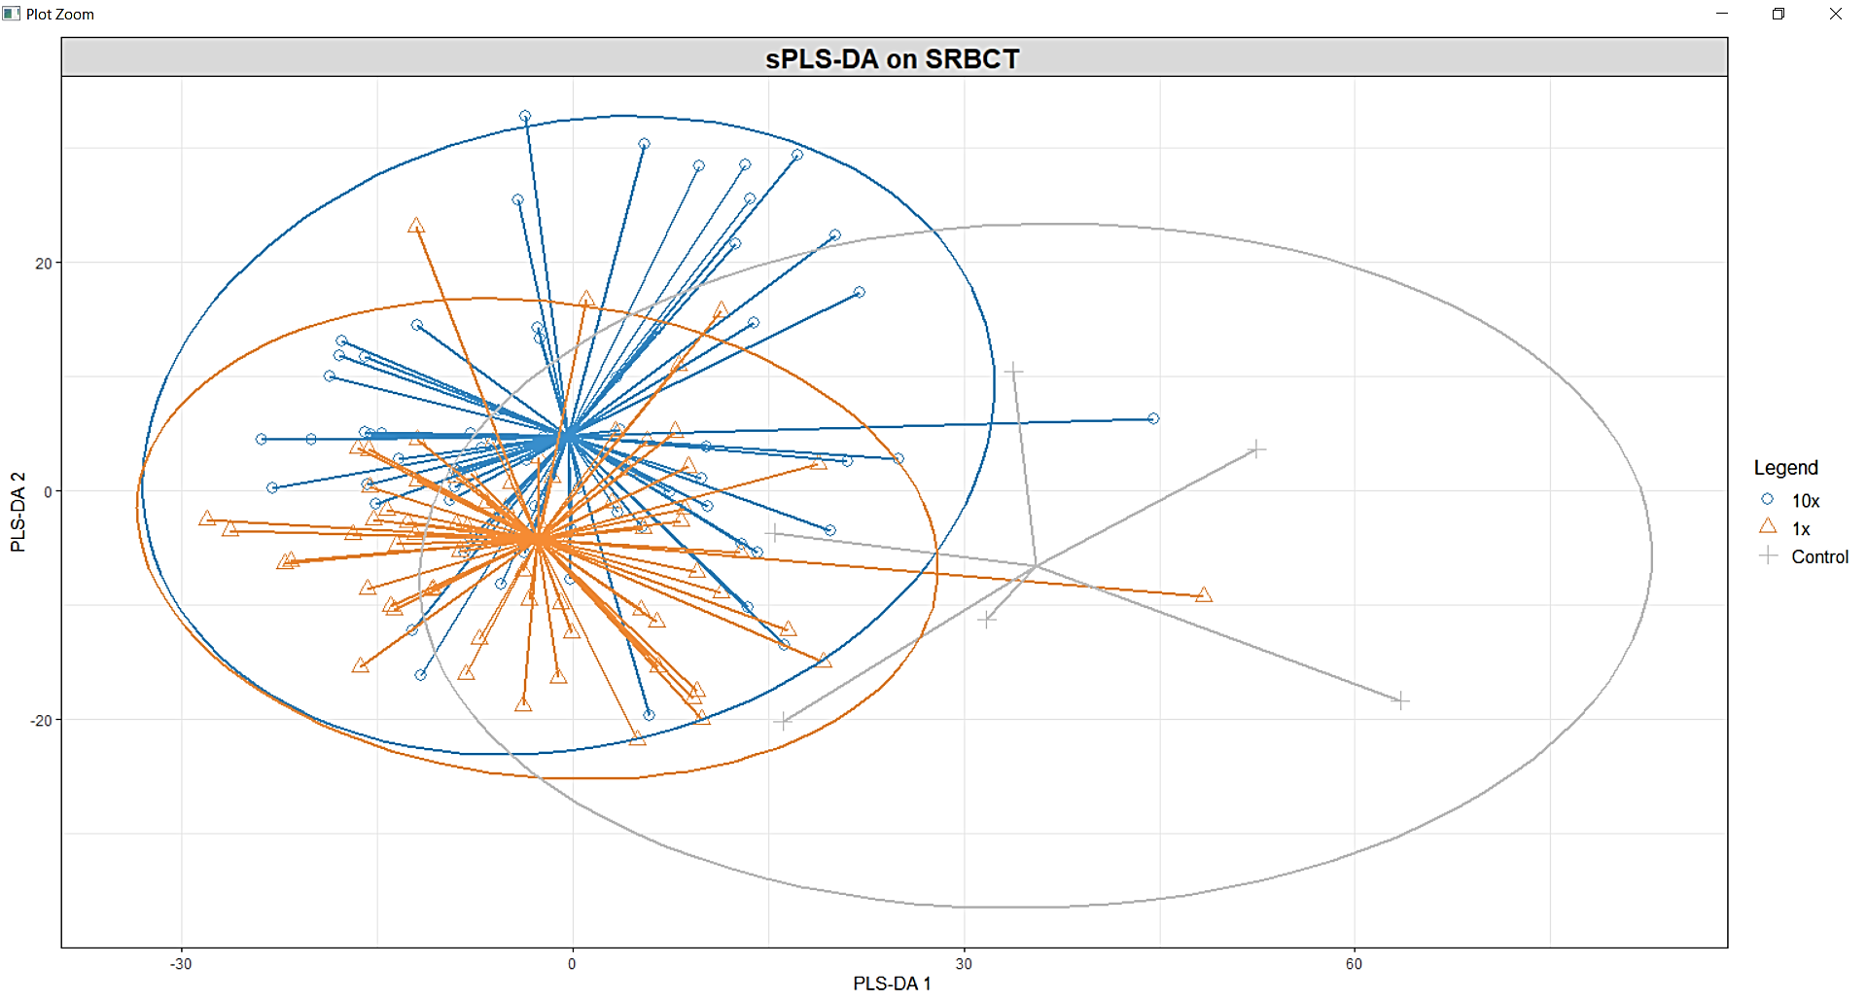
Positive Metabolome
Negative Metabolome

Slide 6
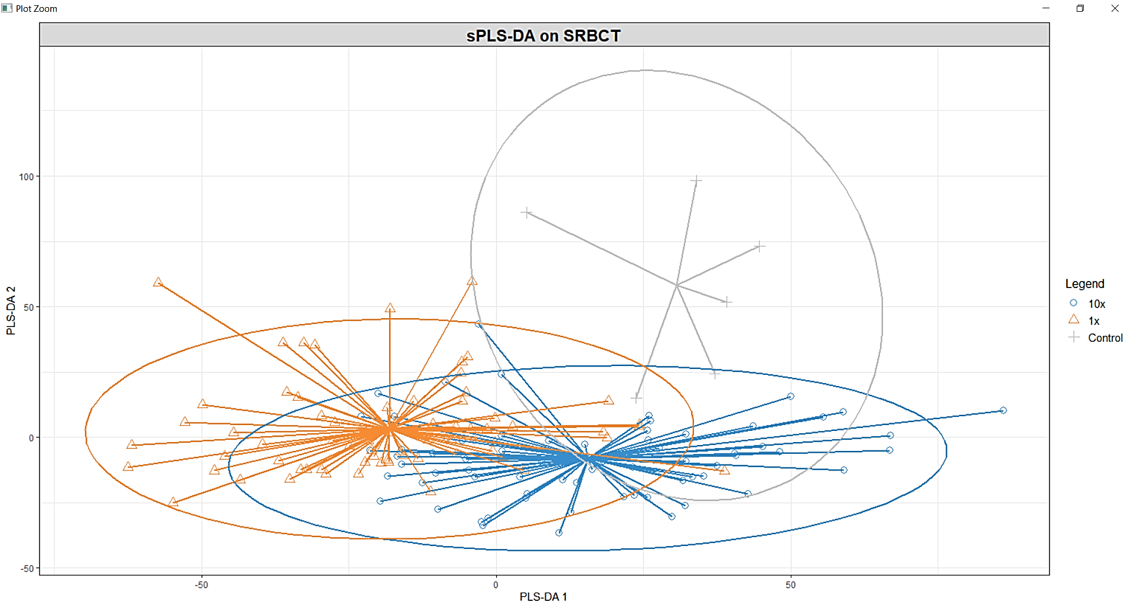
The samples cluster distinctively in the RNA sequence count data.

Slide 7
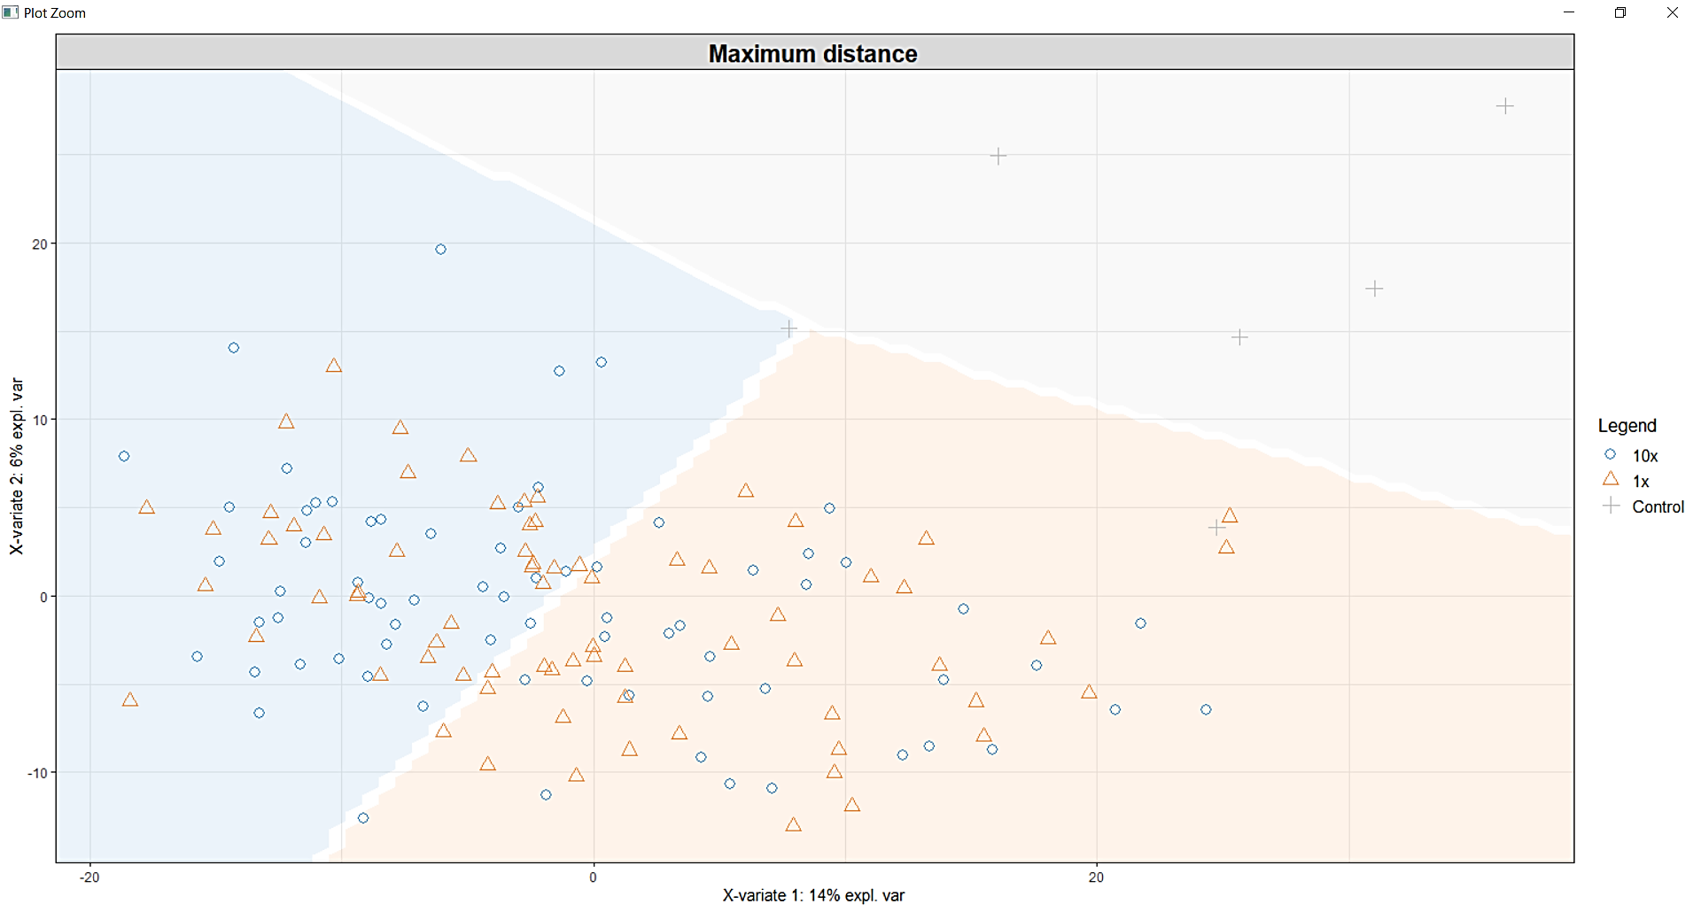
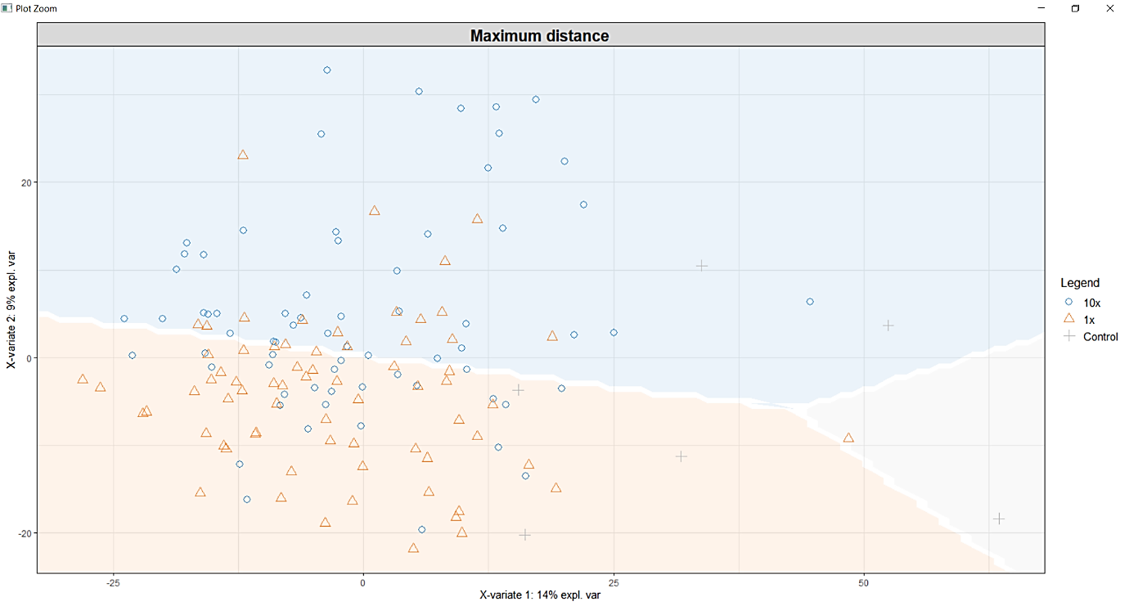
Negative Metabolome
Positive Metabolome

Slide 8
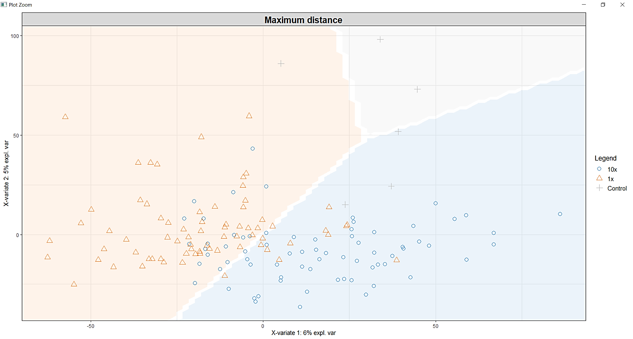
RNA sequence count data classification with the background .

Slide 9
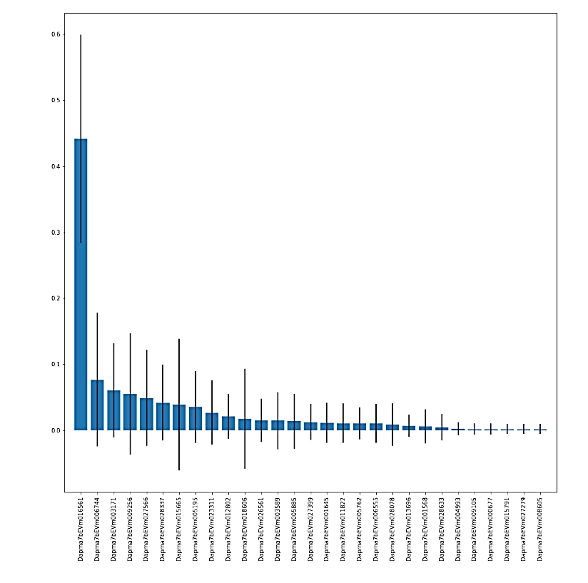
Extract the top features doing IRF on the RNA sequence count data.

Slide 10
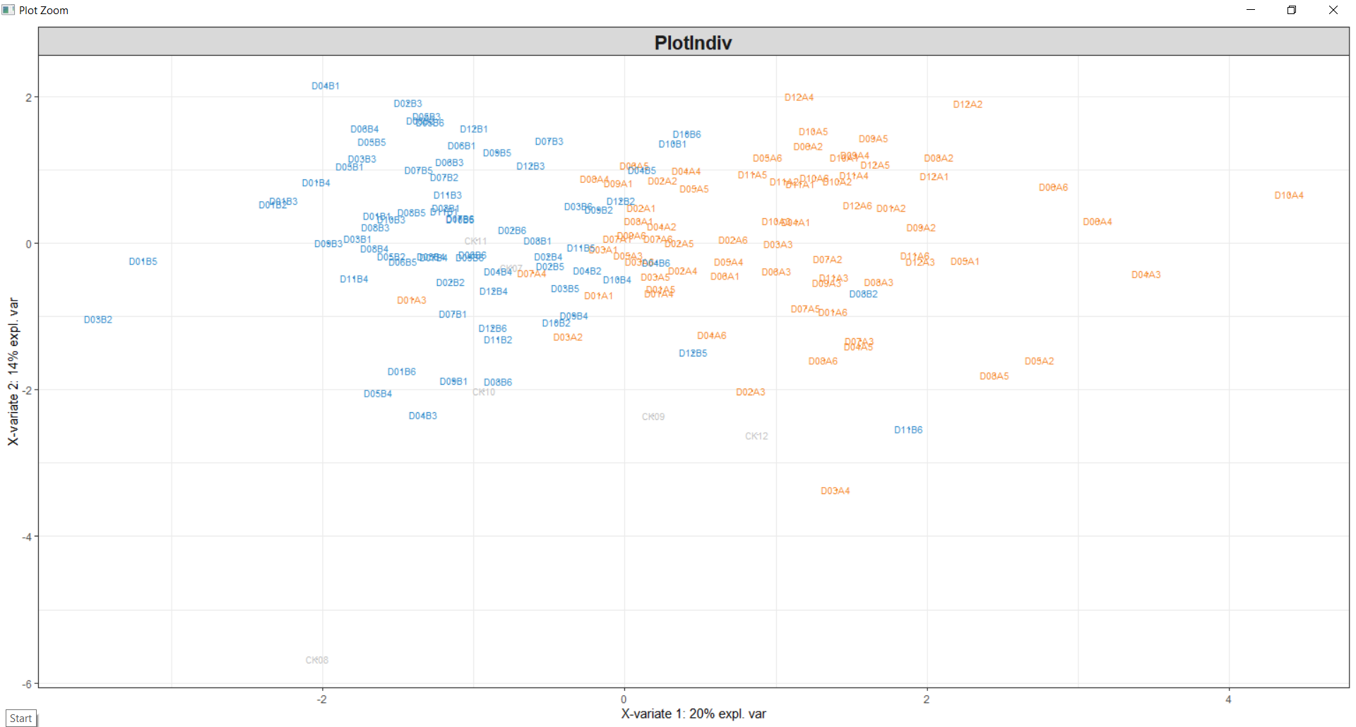
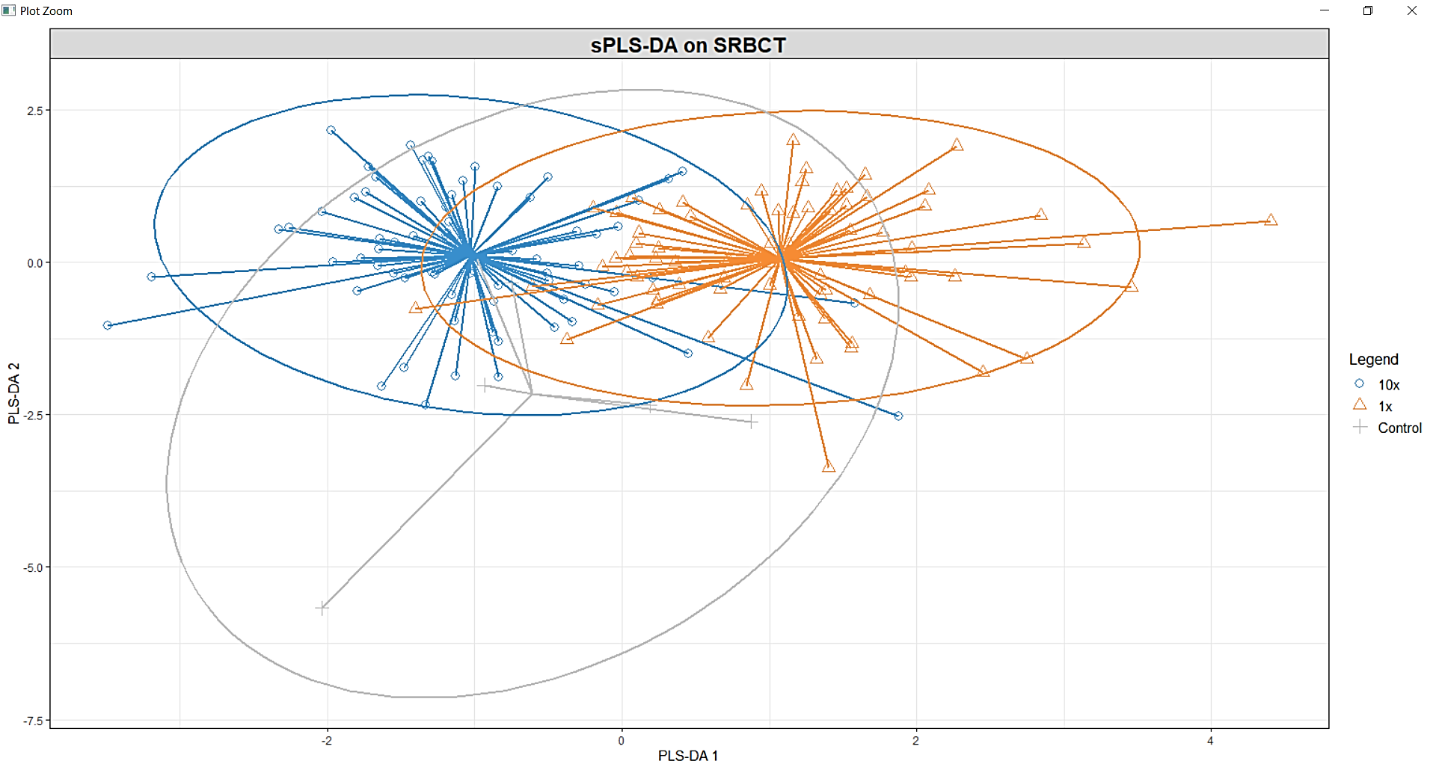
Clustering of the sample after extracting the top 10 features.

Slide 11
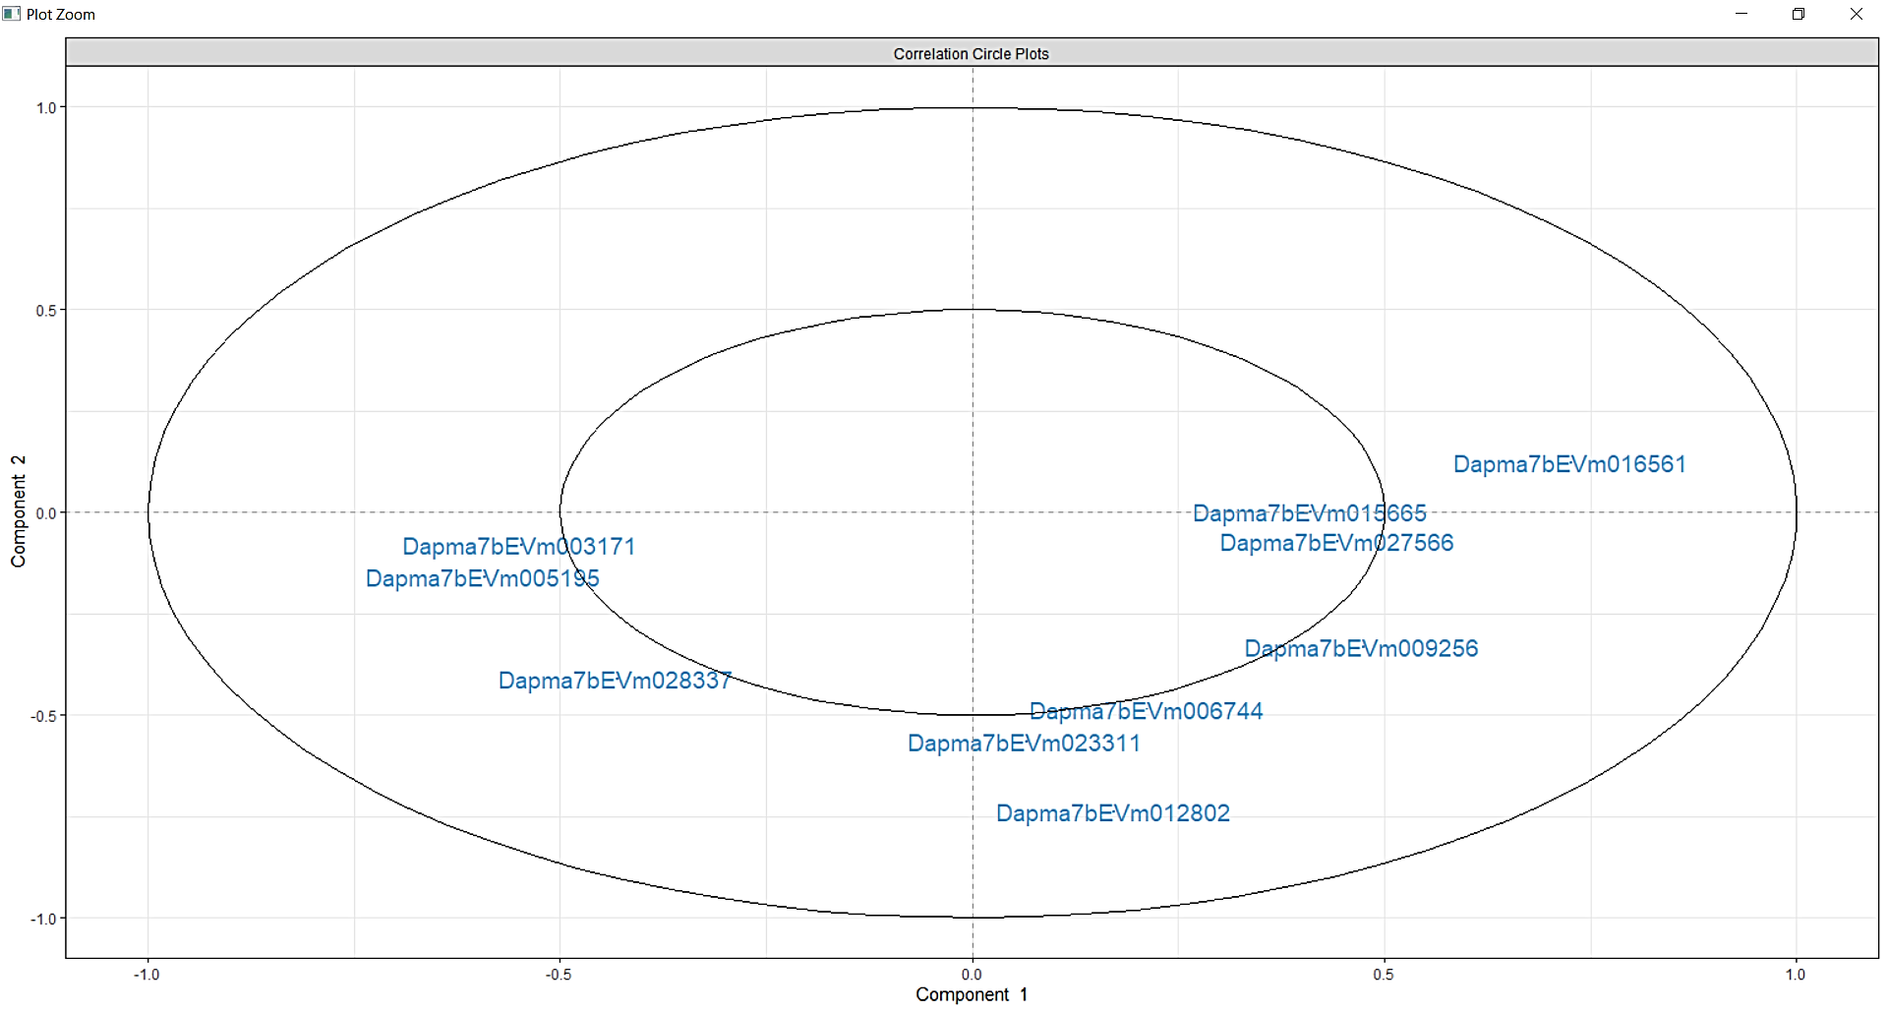
Top 10 variables are plotted and from this we can observe that the variables are clustered away from each other .

Slide 12
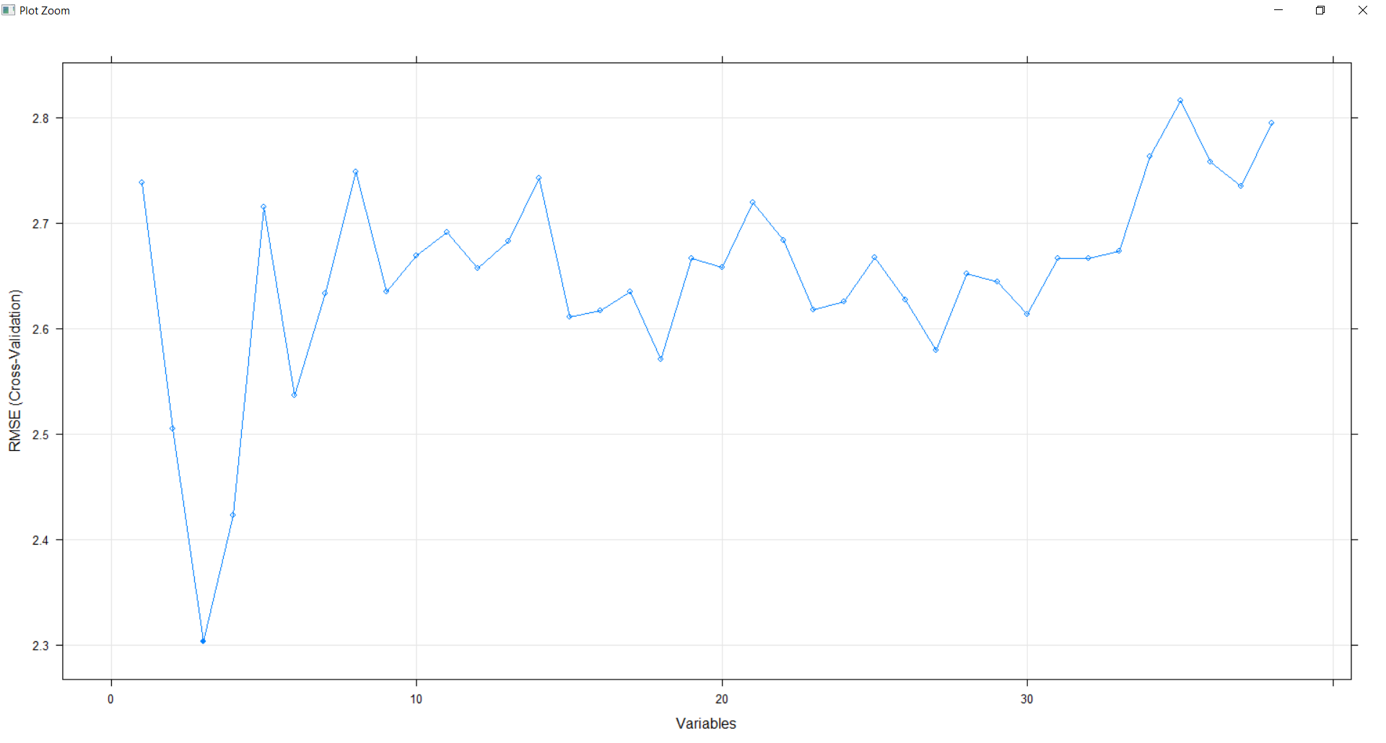
Top feature selection of the chemicals by Recursive Feature Elimination
The top 3 variable are Atrazine-desethyl, Tramadol, 1H-Benzotriazole.
These 3 chemicals might have a most significant outcome on the daphnia .

Slide 13
Differential Analysis Using limma
The differential gene analysis is conducted using limma .
Why limma ? Rounding the count data before subjecting it to Deseq2 might lead to loss in information hence limma was chosen over Deseq2.
There are 150 samples in total and there are 18,903 genes in the transcriptome profiling data that was provided.
There are more significant genes that were discovered in the Control vs 1x sample when compared to the Control vs 10x samples.
The significant genes that were discovered was matched with their respective human genes.

Slide 14
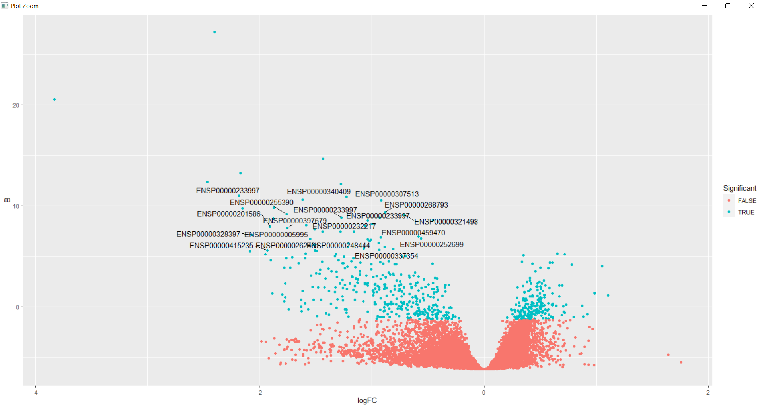
Control vs 1x Differentially Expressed Gene .
131 significant genes were identified in daphnia.
But only a few matched with the homosapien protein ID provided in the annotation.
This plot represent the differentially expressed homosapien proteins

Slide 15
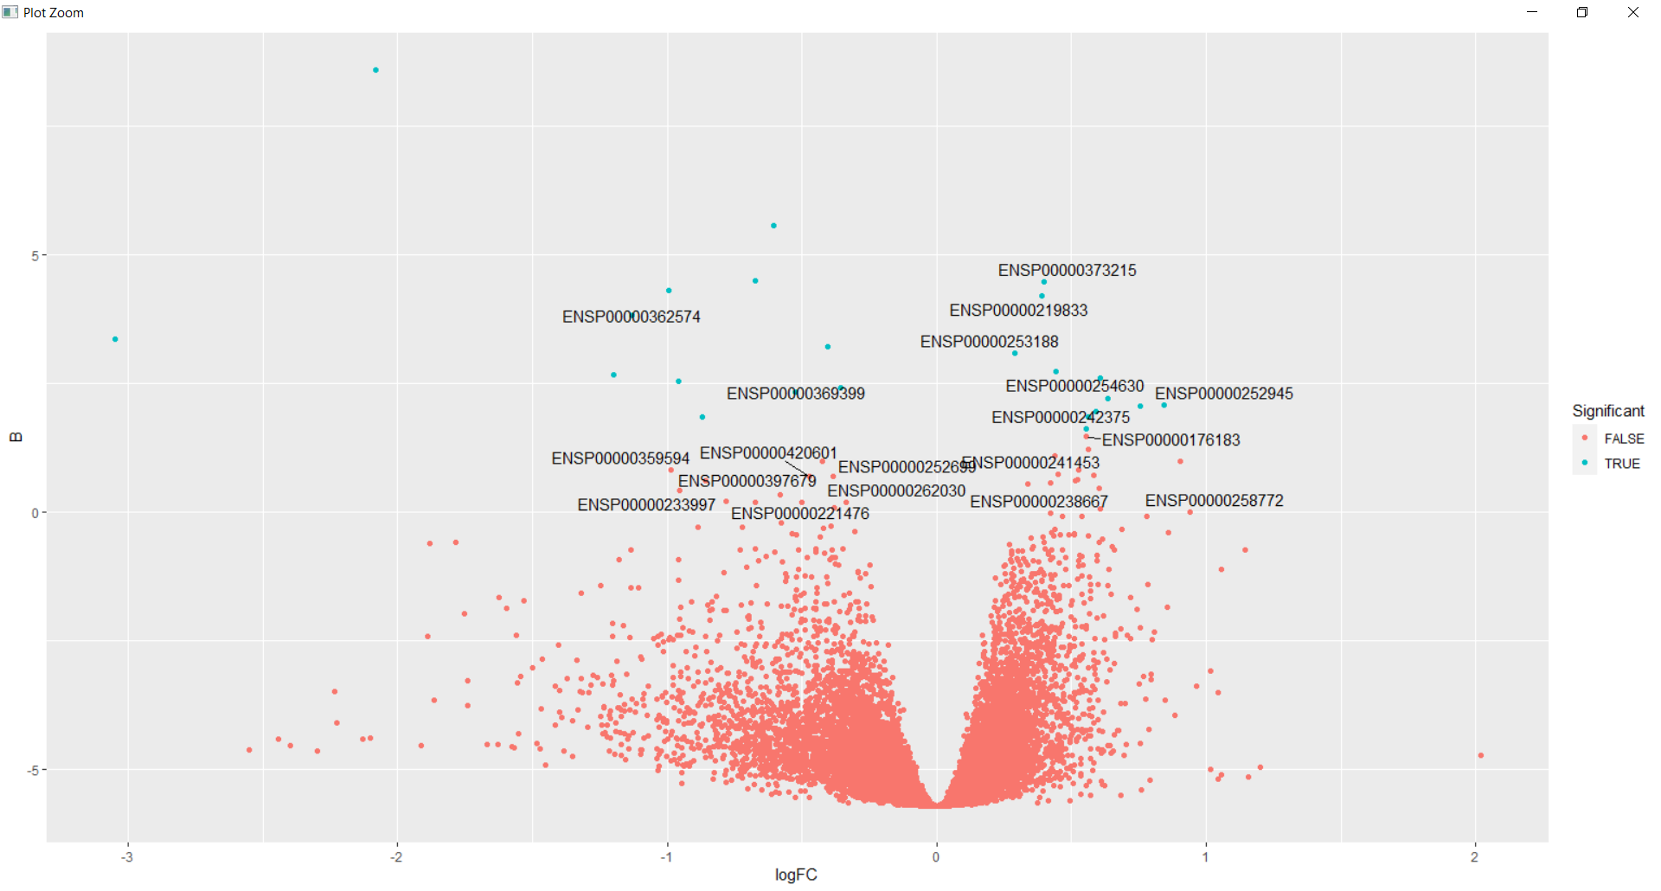
Control vs 10x Differentially Expressed Gene .
4 significant genes were identified in Daphnia.
Here the plot contains the homosapien protein labels.
Further it was matched to their respective genes and analysed.

Slide 16
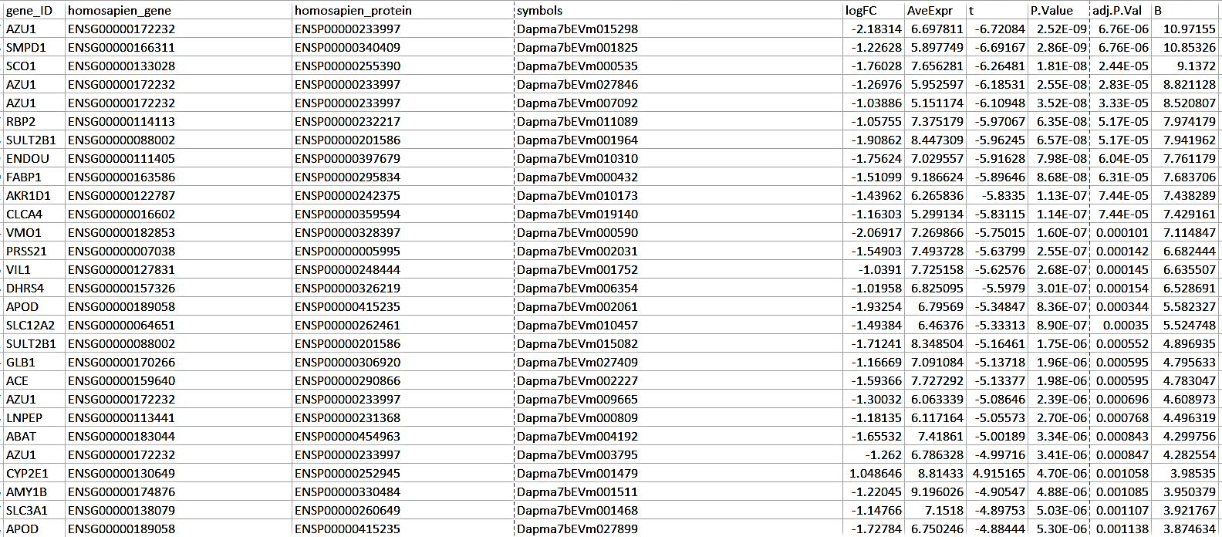
68 differentially expressed genes were similar to the human in the normal vs 1x .
Some are mentioned in the table here

Slide 17
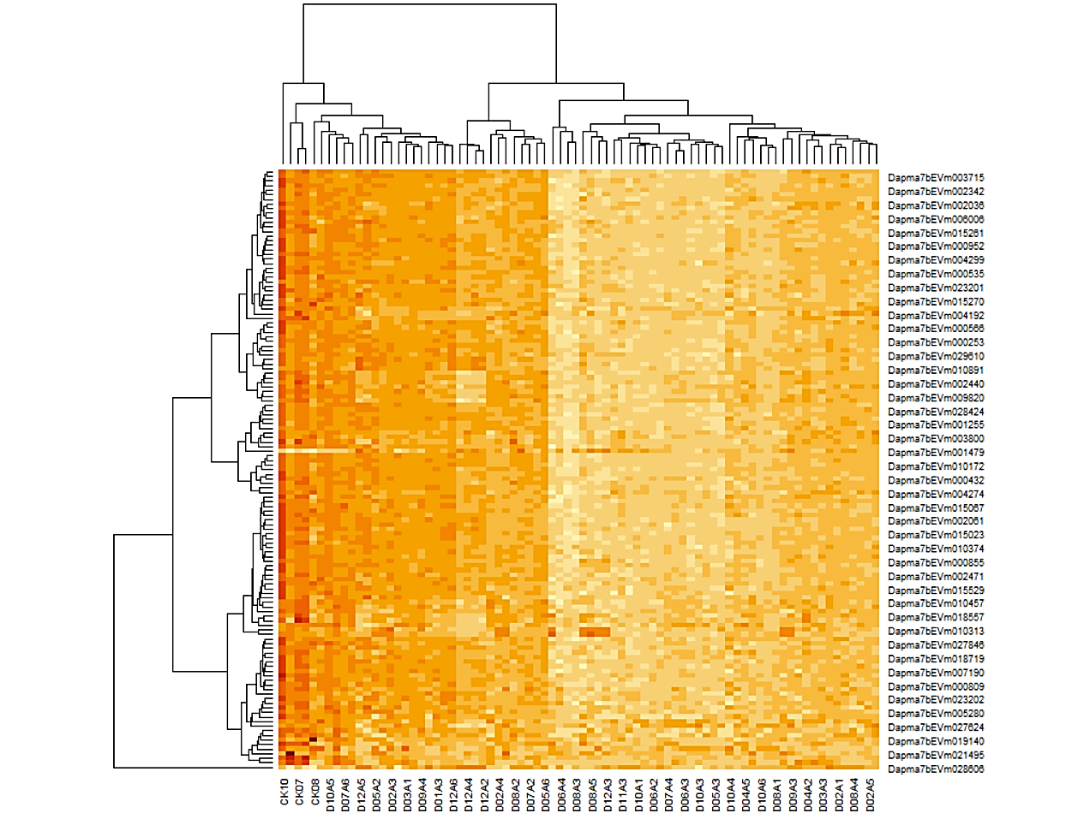
Control vs 1X Significant genes heatmap

Slide 18
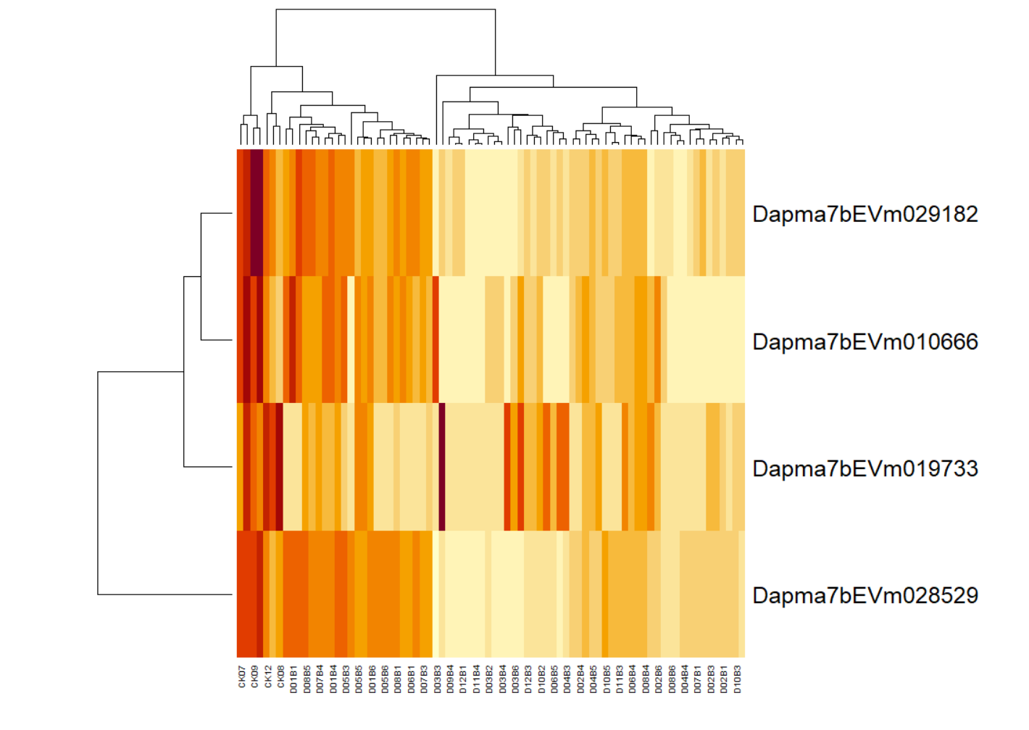
Control vs 10X Significant genes heatmap

Slide 19
Findings :
Differential expression analysis between the control and the samples has identified significant genes.
These significant genes were related to the human genes and further analysis was conducted.
Out of 131 significant genes in the control vs 1 sample only 68 genes correlated with the human and in control vs 10x out of 4 significant differentially expressed gene only one correlated with the human.
In normal vs 10x Dapma7bEVm019733 daphnia gene matched to human S100PBP gene.
Down regulation of S100PBP gene causes reduced PDAC cell adhesion but loss of S100PBP might cause metastatic spread as well. [1]
This gene is involved in breast cancer as well.[2]
The genes which were significant in control vs 1x were mostly involved in metabolism pathway and signal transduction pathway .

Slide 20
The top significant gene in control vs 1x sample is the AZU1 gene.
This gene is an important multifunctional inflammatory mediator.
The other gene which is significant is the SMPD1 sphingomyelin phosphodiesterase 1 gene.
Any defect in this gene will lead to Niemann-Pick disease.
Nieman-Pick disease is related to the lysosomal disorder and they do not have a therapy that could cure the disease. [3]

Slide 21
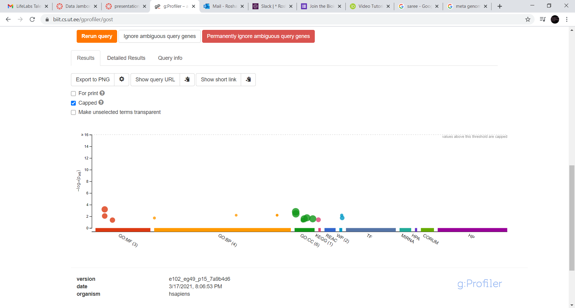
Pathway Enrichment Analysis

Slide 22
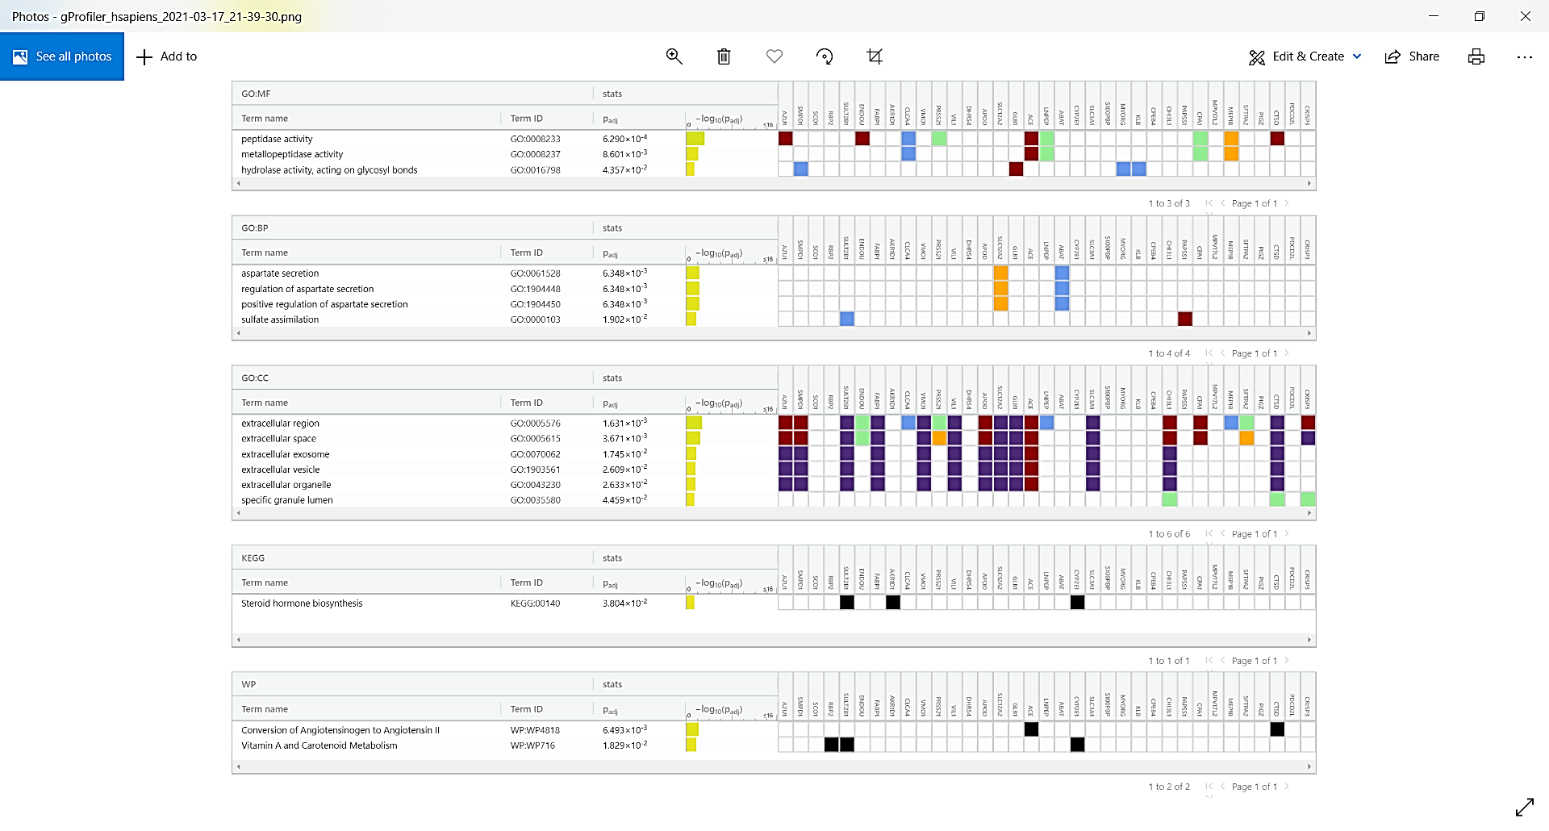

Slide 23
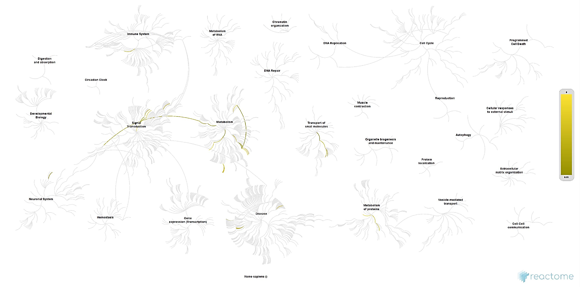
Reactome – Pathway in which the genes are involved

Slide 24
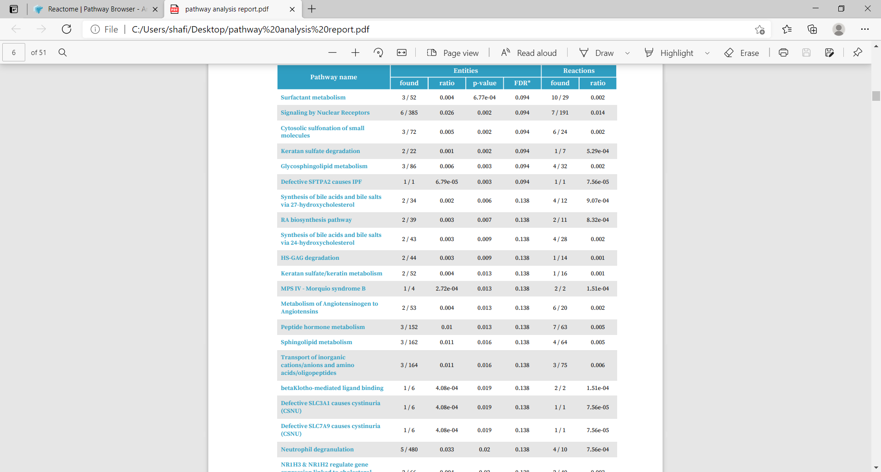
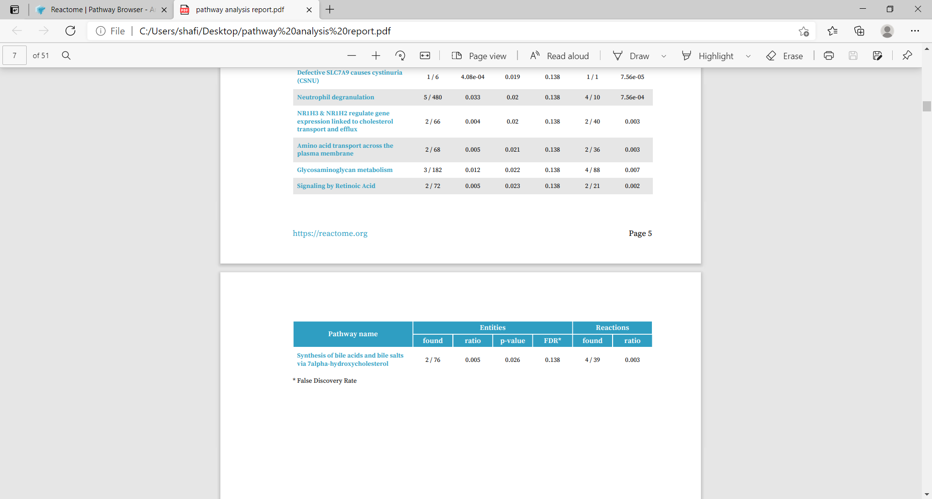
Reactome | Pathway Browser

Slide 25

Further Studies :
Try to correlate the obtained significant genes to Daphnia pulex and Drosophila melanogaster to observe their changes .
Extract the top features from all the dataset merge them and see how the samples cluster.
Derive biological interpretation of the results obtained .

Slide 26
References :
1. Kate E. Lines, Claude Chelala, Branko Dmitrovic, Nilukshi Wijesuriya, Hemant M. Kocher, John F. Marshall, Tatjana Crnogorac-Jurcevic,S100P-Binding Protein, S100PBP, Mediates Adhesion through Regulation of Cathepsin Z in Pancreatic Cancer Cells,The American Journal of Pathology,Volume 180, Issue 4,
2. Al Amri, W.S., Baxter, D.E., Hanby, A.M. et al. Identification of candidate mediators of chemoresponse in breast cancer through therapy-driven selection of somatic variants. Breast Cancer Res Treat 183, 607–616 (2020). Al Amri, W.S., Baxter, D.E., Hanby, A.M. et al. Identification of candidate mediators of chemoresponse in breast cancer through therapy-driven selection of somatic variants. Breast Cancer Res Treat 183, 607–616 (2020).
3. Patterson M. Niemann-Pick Disease Type C. 2000 Jan 26 [Updated 2020 Dec 10]. In: Adam MP, Ardinger HH, Pagon RA, et al., editors. GeneReviews® [Internet]. Seattle (WA): University of Washington, Seattle; 1993-2021

